Slide 1
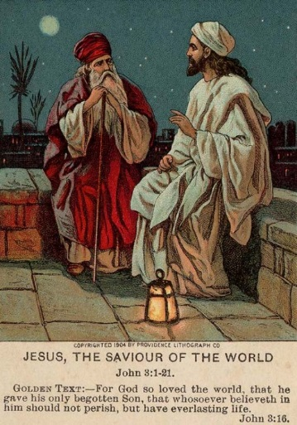
John 3.1-21
Image produced by Providence Lithograph Company;
taken from biblelessonsite.org

Slide 2
John 3.1-2 [NET]: Now a certain man, a Pharisee named Nicodemus, who was a member of the Jewish ruling council, came to Jesus at night and said to him, “Rabbi, we know
that you are a teacher
who has come from God.
For no one could perform
the miraculous signs that
you do unless God is
with him.”

Slide 3
John 3.1-2 [NET]: Now a certain man, a Pharisee named Nicodemus, who was a member of the Jewish ruling council, came to Jesus at night and said to him, “Rabbi, we know
that you are a teacher
who has come from God.
For no one could perform
the miraculous signs that
you do unless God is
with him.”

Slide 4
John 3.1-2 [NET]: Now a certain man, a Pharisee named Nicodemus, who was a member of the Jewish ruling council, came to Jesus at night and said to him, “Rabbi, we know
that you are a teacher
who has come from God.
For no one could perform
the miraculous signs that
you do unless God is
with him.”
δέ signals a new topic
related to the previous
topic in 2.23-25.

Slide 5

John 3.3-4: Jesus replied, “I tell you the solemn truth, unless a person is
born from above, he cannot
see the kingdom of God.”
Nicodemus said to him,
“How can a man be born
when he is old? He cannot
enter his mother's womb
and be born a second time,
can he?”
Taylor James

Slide 6
John 3.3-4: Jesus replied, “I tell you the solemn truth, unless a person is
born from above, he cannot
see the kingdom of God.”
ἄνωθεν = again/from above
Nicodemus said to him,
“How can a man be born
when he is old? He cannot
enter his mother's womb
and be born a second time,
can he?”
Taylor James

Slide 7
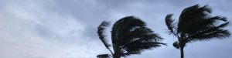
John 3.5-8: Jesus answered, “I tell you the solemn truth, unless a person is born of water and spirit, he cannot enter the kingdom of God. What is born of the flesh is flesh, and what is born of the Spirit is spirit. Do not be amazed that I said to you, ‘You must all be born from above.’ The wind blows wherever it will, and you hear the sound it makes, but do not know where it comes from and where it is going. So it is with everyone who is born of the Spirit.”

Slide 8
Ezekiel 36.25-27 [NASB]: “Then I will sprinkle clean water on you, and you will be clean; I will cleanse you from all your filthiness and from all your idols. Moreover, I will give you a new heart and put a new spirit within you; and I will remove the heart of stone from your flesh and give you a heart of flesh. I will put My Spirit within you and cause you to walk in My statutes, and you will be careful to observe My ordinances.”

Slide 9
John 3.5-8: Jesus answered, “I tell you the solemn truth, unless a person is born of water and spirit, he cannot enter the kingdom of God. What is born of the flesh is flesh, and what is born of the Spirit is spirit. Do not be amazed that I said to you, ‘You must all be born from above.’ The wind blows wherever it will, and you hear the sound it makes, but do not know where it comes from and where it is going. So it is with everyone who is born of the Spirit.”

Slide 10
John 3.5-8: Jesus answered, “I tell you the solemn truth, unless a person is born of water and spirit, he cannot enter the kingdom of God. What is born of the flesh is flesh, and what is born of the Spirit is spirit. Do not be amazed that I said to you, ‘You must all be born from above.’ The wind blows wherever it will, and you hear the sound it makes, but do not know where it comes from and where it is going. So it is with everyone who is born of the Spirit.”

Slide 11
John 3.9-15: Nicodemus replied, “How can these things be?” Jesus answered, “Are you the teacher of Israel and yet you don't understand these things? I tell you the solemn truth, we speak about what we know and testify about what we have seen, but you people do not accept our testimony. If I have told you people about earthly things and you don't believe, how will you believe if I tell you about heavenly things? No one has ascended into heaven except the one who descended from heaven– the Son of Man. Just as Moses lifted up the serpent in the wilderness, so must the Son of Man be lifted up, so that everyone who believes in him may have eternal life.”

Slide 12
John 3.9-15: Nicodemus replied, “How can these things be?” Jesus answered, “Are you the teacher of Israel and yet you don't understand these things? I tell you the solemn truth, we speak about what we know and testify about what we have seen, but you people do not accept our testimony. If I have told you people about earthly things and you don't believe, how will you believe if I tell you about heavenly things? No one has ascended into heaven except the one who descended from heaven– the Son of Man. Just as Moses lifted up the serpent in the wilderness, so must the Son of Man be lifted up, so that everyone who believes in him may have eternal life.”

Slide 13
John 3.9-15: Nicodemus replied, “How can these things be?” Jesus answered, “Are you the teacher of Israel and yet you don't understand these things? I tell you the solemn truth, we speak about what we know and testify about what we have seen, but you people do not accept our testimony. If I have told you people about earthly things and you don't believe, how will you believe if I tell you about heavenly things? No one has ascended into heaven except the one who descended from heaven– the Son of Man. Just as Moses lifted up the serpent in the wilderness, so must the Son of Man be lifted up, so that everyone who believes in him may have eternal life.”

Slide 14
John 3.9-15: Nicodemus replied, “How can these things be?” Jesus answered, “Are you the teacher of Israel and yet you don't understand these things? I tell you the solemn truth, we speak about what we know and testify about what we have seen, but you people do not accept our testimony. If I have told you people about earthly things and you don't believe, how will you believe if I tell you about heavenly things? No one has ascended into heaven except the one who descended from heaven– the Son of Man. Just as Moses lifted up the serpent in the wilderness, so must the Son of Man be lifted up, so that everyone who believes in him may have eternal life.”

Slide 15
John 3.16-18: For this is the way God loved the world: He gave his one and only Son, so that everyone who believes in him will not perish but have eternal life. For God did not send his Son into the world to condemn the world, but that the world should be saved through him. The one who believes in him is not condemned. The one who does not believe has been condemned already, because he has not believed in the name of the one and only Son of God.

Slide 16
John 3.16: For this is the way God loved the world: He gave his one and only Son, so that everyone who believes in him will not perish but have eternal life.
Present tense, especially participle form, of πιστεύω in the gospel of John implies true faith and a faith that is continuous.
Everyone who is believing

Slide 17
John 3.16-18: For this is the way God loved the world: He gave his one and only Son, so that everyone who believes in him will not perish but have eternal life. For God did not send his Son into the world to condemn the world, but that the world should be saved through him. The one who believes in him is not condemned. The one who does not believe has been condemned already, because he has not believed in the name of the one and only Son of God.
Κρίνω = I judge / I condemn

Slide 18
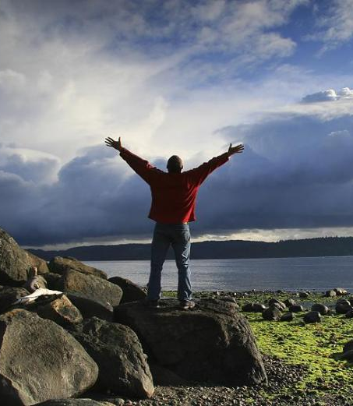
John 3.19-21: Now this is the
basis for judging: that the light
has come into the world and
people loved the darkness
rather than the light, because
their deeds were evil. For
everyone who does evil deeds
hates the light and does not
come to the light, so that their
deeds will not be exposed. But the one who practices the truth comes to the light, so that it may be plainly evident that his deeds have been done in God.
drewcuster.wordpress.com

Slide 19
Empowered to do miracles
The wisest teacher
The Son of Man, God’s representative and eternal king.
The Savior crucified then exalted, who brings new and eternal life.
The Son of God sent by the Father to offer salvation.
The light that gives life.
Who is Jesus?

